Slide 1
Business Case Solving
Cochin Traders
By Preethi Tony

Slide 2
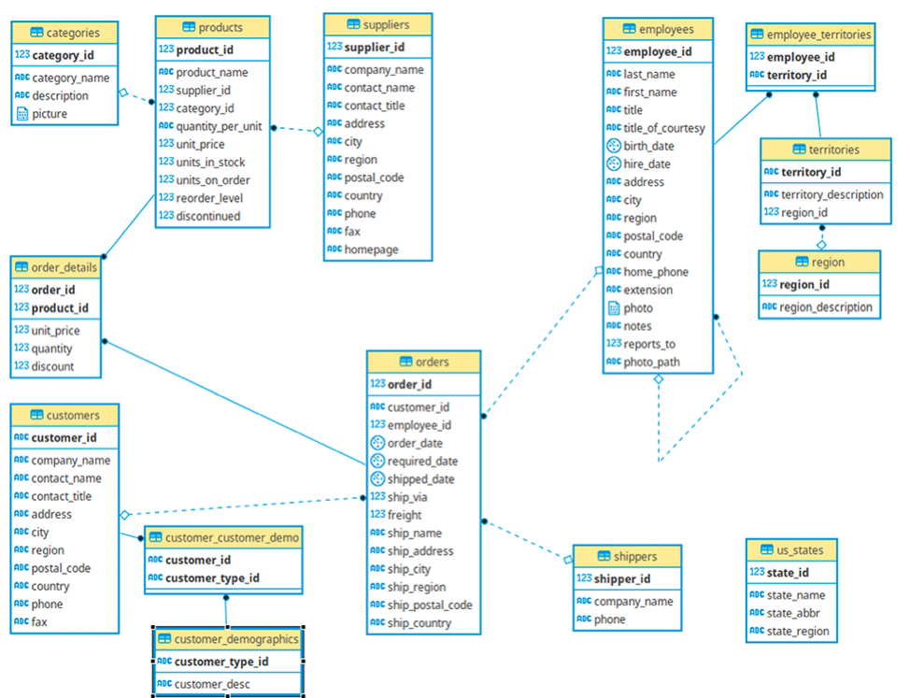
Schema

Slide 3
Tables used:
Customers
Suppliers
Employees
Products
Shippers
Orders
Order_Details

Slide 4
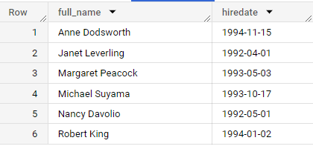
Ques. Fetch the full name and hiring date of all Employees who work as Sales Representatives.
select concat(firstname,' ',lastname) as full_name, hiredate
from `cochin_traders.employees`
where title = "Sales Representative"
order by full_name
The data analysis reveals key details about the Sales Representatives' team within the company. By extracting the full names and hiring dates of these employees, we gain insights into the team's composition and growth over time.

Slide 5
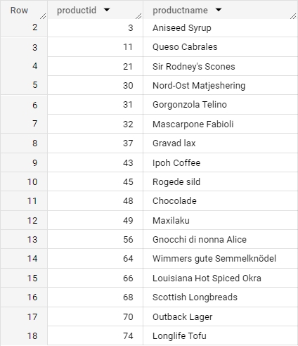
Ques. Which of the products in our inventory need to be reordered?
select productid,productname
from `cochin_traders.products`
where unitsinstock < reorderlevel
order by productid
By Finding out the stock levels we can proactively address potential stockouts and ensure uninterrupted availability to meet customer demands.

Slide 6
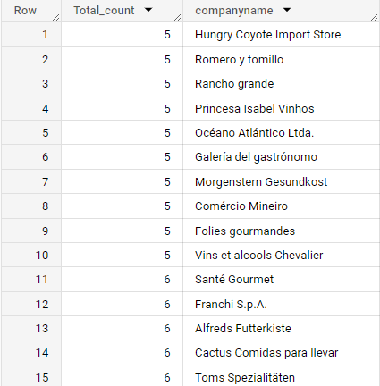
Ques. Find and display the details of customers who have placed more than 5 orders.
select count(o.orderid) as Total_count, c.companyname
from `cochin_traders.customers` c left join `cochin_traders.orders` o
on c.customerid=o.customerid
group by c.companyname
having count(o.orderid) >= 5
order by Total_count
limit 15
By finding out the top customers we can identify the loyal customers, driving repeat business, and ultimately contributing to the company's sustainable growth

Slide 7
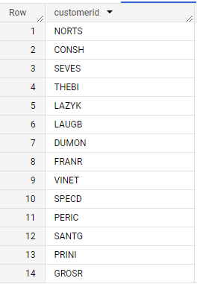
Ques: An employee of ours (Margaret Peacock, EmployeeID 4) has the record of completing most orders. However, there are some customers who've never placed an order with her. Show such customers.
select distinct customerid
from `cochin_traders.orders`
where customerid not in
(
SELECT customerid
from `cochin_traders.orders`
WHERE employeeid = 4
)
This insight prompts us to plan accordingly to bridge this gap and provide more discounts so that all those pending customers can start placing their orders.

Slide 8
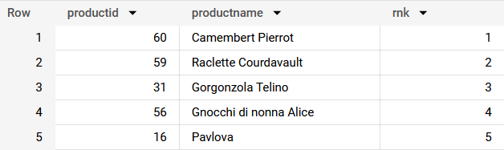
Ques. Retrieve the top 5 best-selling products on the basis of the quantity ordered.
with cte as
(
select productid,sum(quantity) as quantity
from `cochin_traders.orders_details`
group by productid
),
cte2 as
(
select p.productid,p.productname,dense_rank() over(order by quantity desc) as rnk
from cte c join `cochin_traders.products` p
on c.productid=p.productid
)
select *
from cte2
where rnk <=5
order by rnk
Following finding has helped us to tailor down the top 5 best-selling products, determined by the quantity ordered. These products shows that they are customer favorites, showcasing their strong market demand. So, when all these products are always in stock, we're meeting customer preferences effectively.

Slide 9
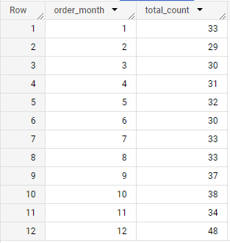
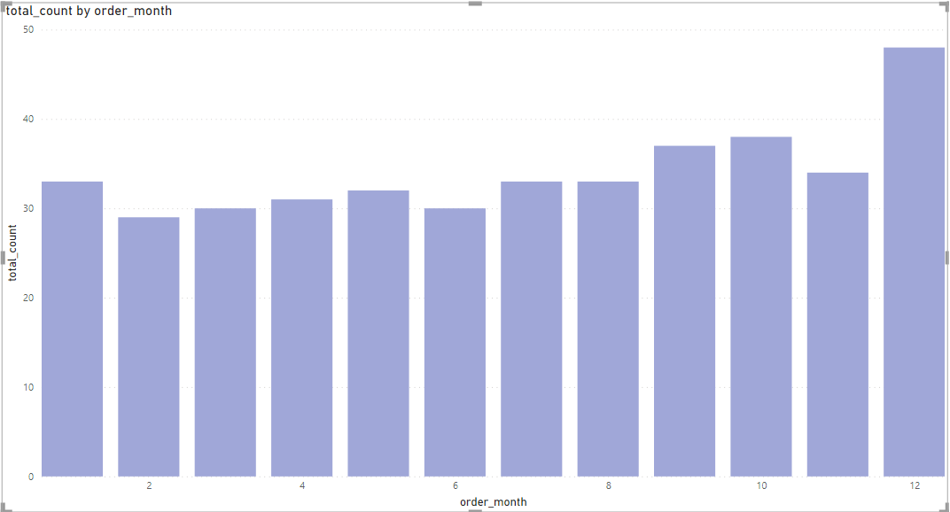
Ques. Analyze the monthly order count for the year 1997.
with cte as
(
select extract(month from orderdate) as order_month,extract(year from orderdate) as order_year,count(orderid) as total_count
from `cochin_traders.orders`
group by order_month,order_year
)
select order_month,total_count from cte
where order_year=1997
order by order_month
By understanding historical fluctuations, we can proactively allocate resources, enhance staffing during busy periods, and strategize promotions to align with high-demand months.

Slide 10
Ques: Calculate the difference in sales revenue for each month compared to the previous month.
with cte as
(
select *,extract(m\onth from o.orderdate) as order_month,
extract(year from o.orderdate) as order_year,
od.unitprice*od.quantity as revenue
from `cochin_traders.orders` o join `cochin_traders.orders_details` od
on o.orderid=od.orderid
),

Slide 11
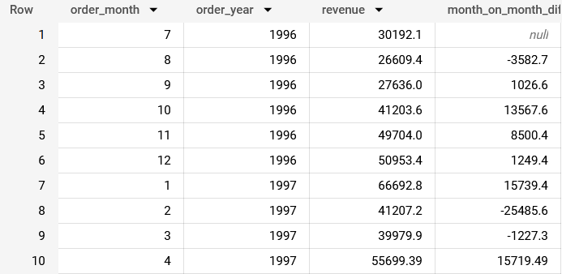
Ques: Calculate the difference in sales revenue for each month compared to the previous month. Cntd..
cte2 as
(
select order_month,order_year,round(sum(revenue),2) as revenue
from cte
group by order_month,order_year
order by order_month,order_year
)
select *,round(cte2.revenue - lag(cte2.revenue) over(order by order_year,order_month),2) as month_on_month_difference
from cte2
order by order_year,order_month
Our data analysis has displayed the
Monthly difference in sales revenue compared to the previous month. This insight offers a wide view of revenue trends, highlighting periods of growth, stability, and potential areas for improvement

Slide 12
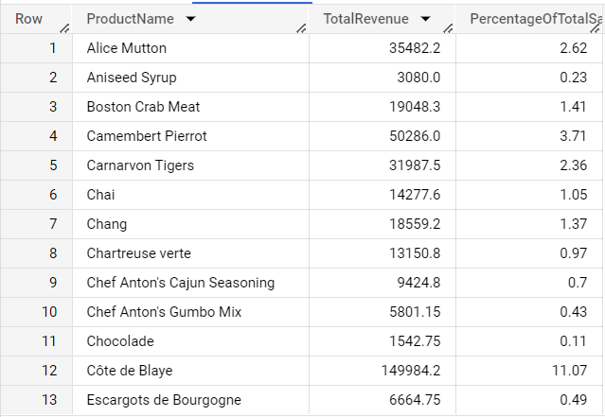
Ques: Calculate the percentage of total sales revenue for each product.
WITH TotalSales AS
(
SELECT SUM(od.UnitPrice * od.Quantity) AS TotalSalesRevenue
FROM `cochin_traders.orders_details` od
)
SELECT p.ProductName, round(SUM(od.UnitPrice * od.Quantity),2) AS TotalRevenue,
round((SUM(od.UnitPrice * od.Quantity) / ts.TotalSalesRevenue) * 100,2) AS PercentageOfTotalSales
FROM `cochin_traders.products` p
JOIN `cochin_traders.orders_details` od
ON p.ProductID = od.ProductID
cross join TotalSales ts
GROUP BY p.ProductName, ts.TotalSalesRevenue
ORDER BY p.productname
Our data-driven approach has allowed us to calculate the percentage of total sales revenue attributed to each individual product. This insight provides a clear understanding of each product's role in our overall revenue stream.

